Slide 1
Food Order Phase 1 deploy in AWS with Docker and jenkin

Slide 2
This project present in git repository in below URL
https://github.com/Kaleakash/phase1_food_ordering.git
Plz login to virtual lab and clone this project in virtual lab using command as
git clone https://github.com/Kaleakash/phase1_food_ordering.git

Slide 3
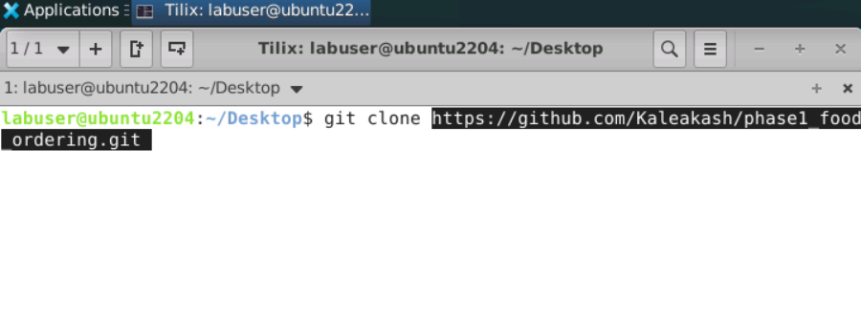

Slide 4
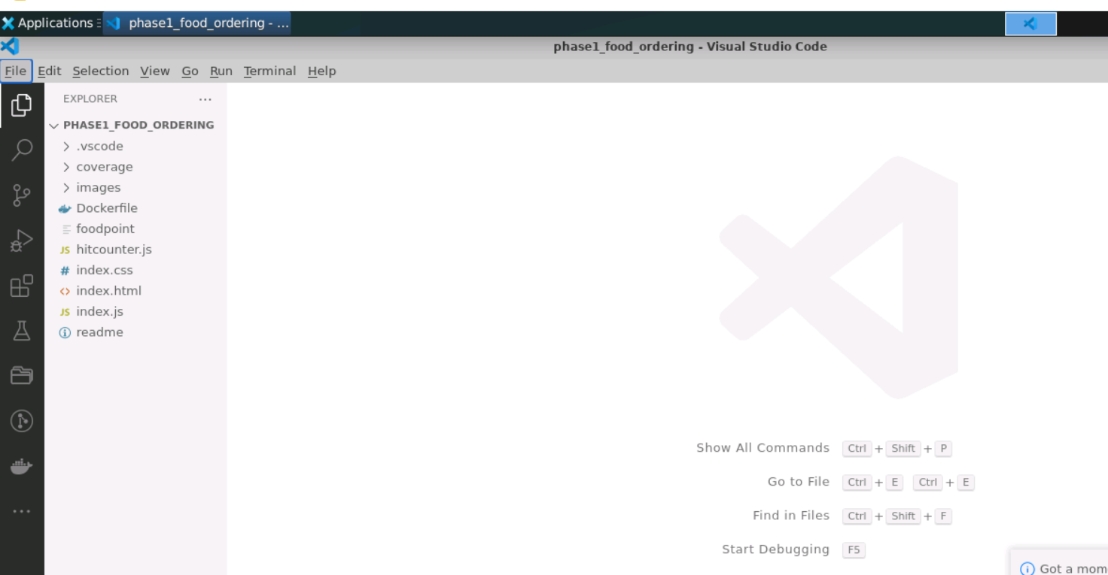
In Virtual lab open this project in VSCode

Slide 5
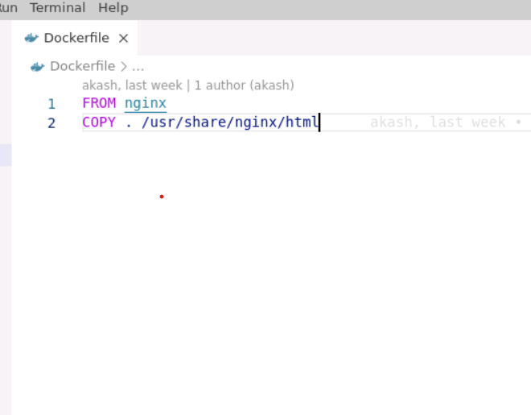
Now we need to create the Dockerfile
Dockerfile (no extentsion)
FROM nginx
COPY . /usr/share/nginx/html
Here nginx is server which we are
going to pull and then we copy
and paste all code in nginx server.

Slide 6
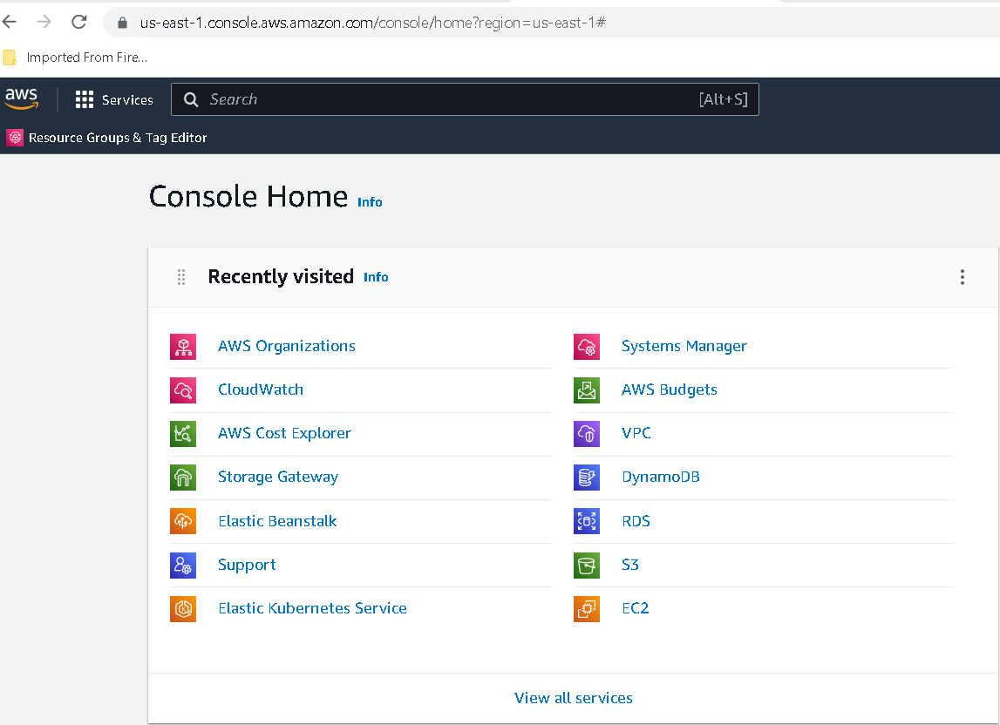
Now we do the login for aws

Slide 7
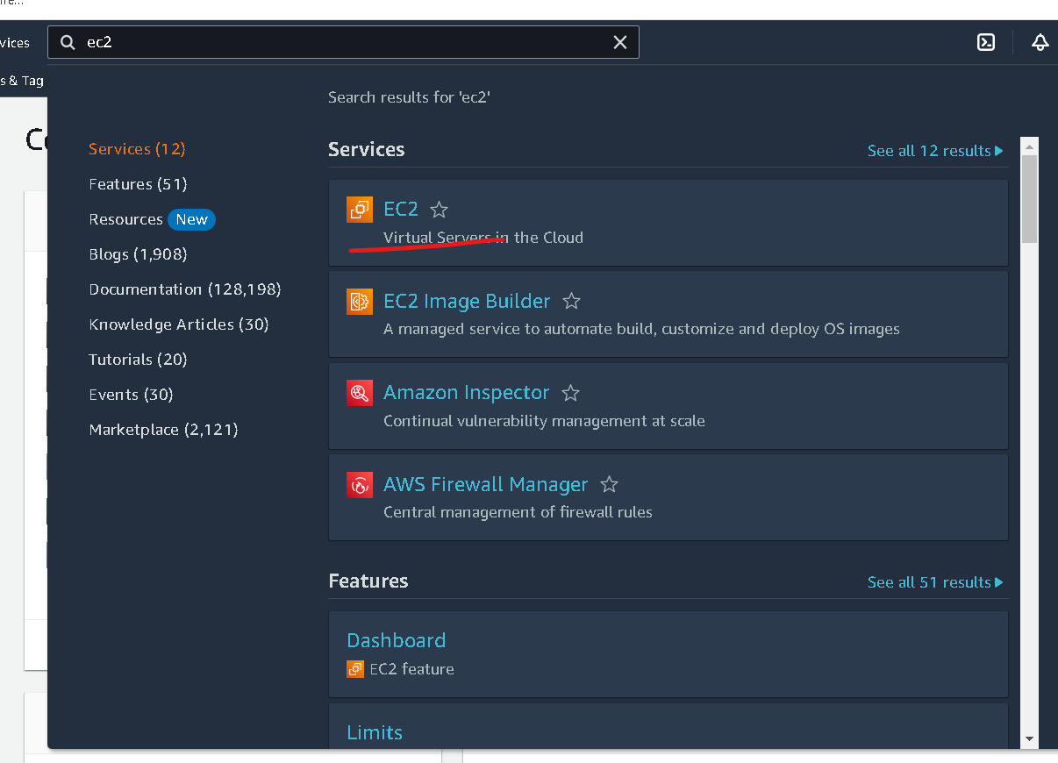
In Search bar search EC2 instance

Slide 8
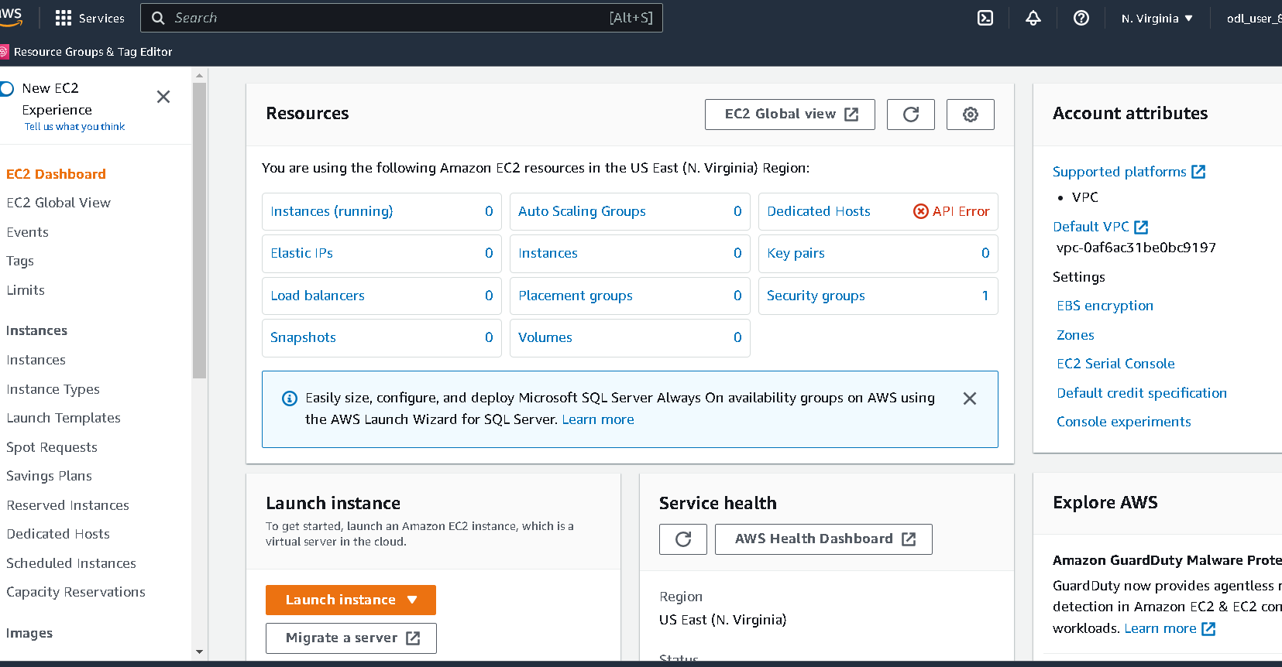

Slide 9
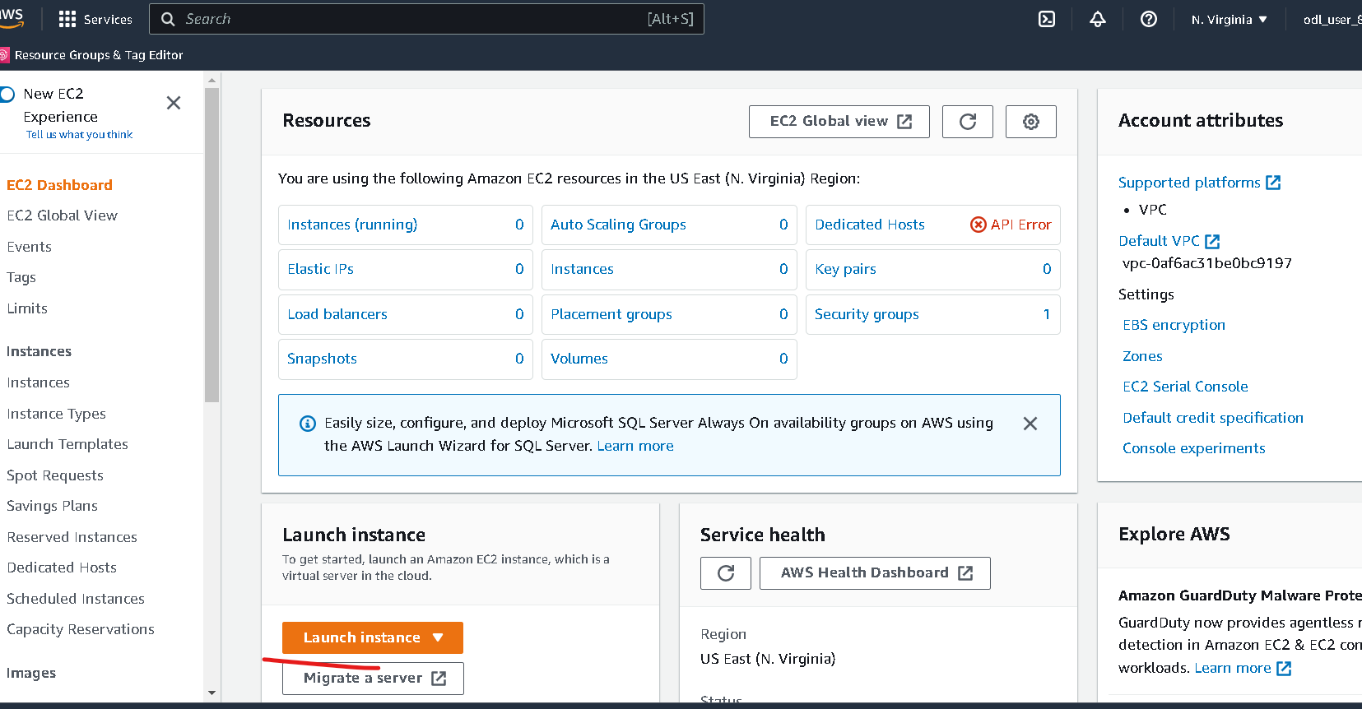
Now you have to click on launch button

Slide 10
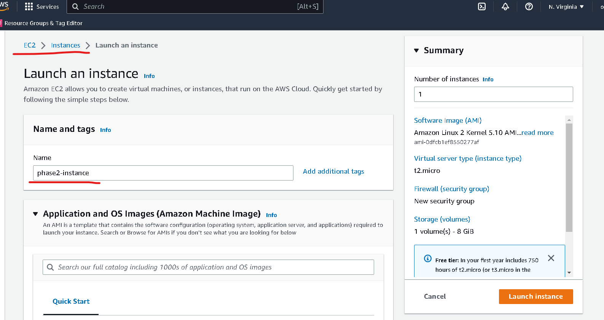
Instance name can be anything :phase2-instance

Slide 11
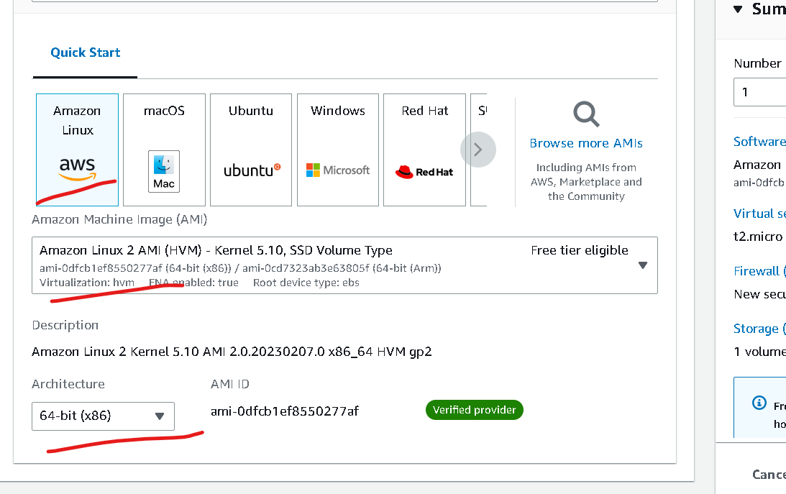
No changes – default option

Slide 12
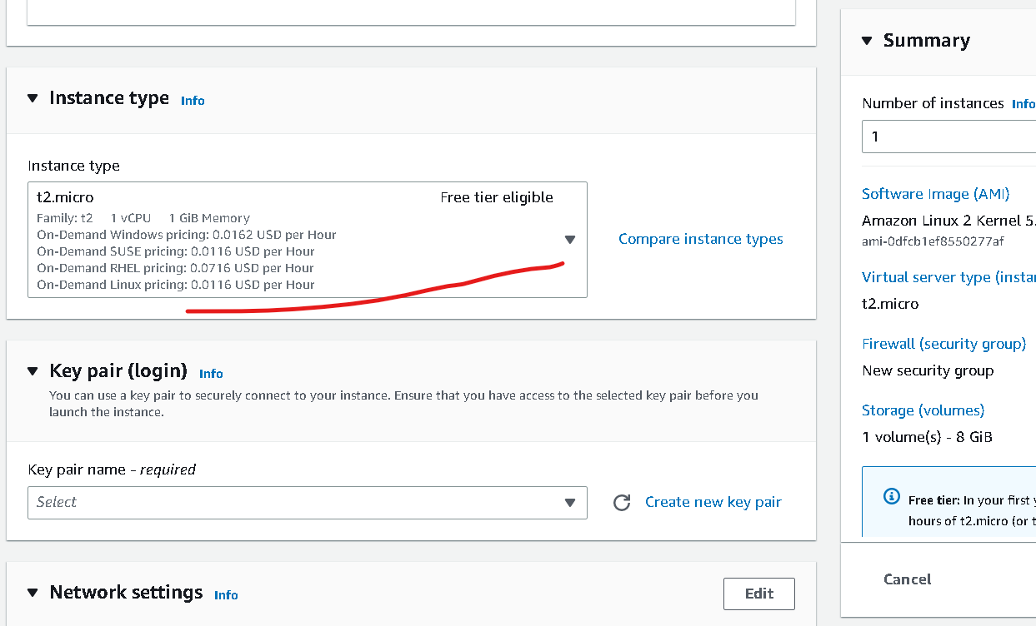
Instance type – free tier (don’t change)

Slide 13
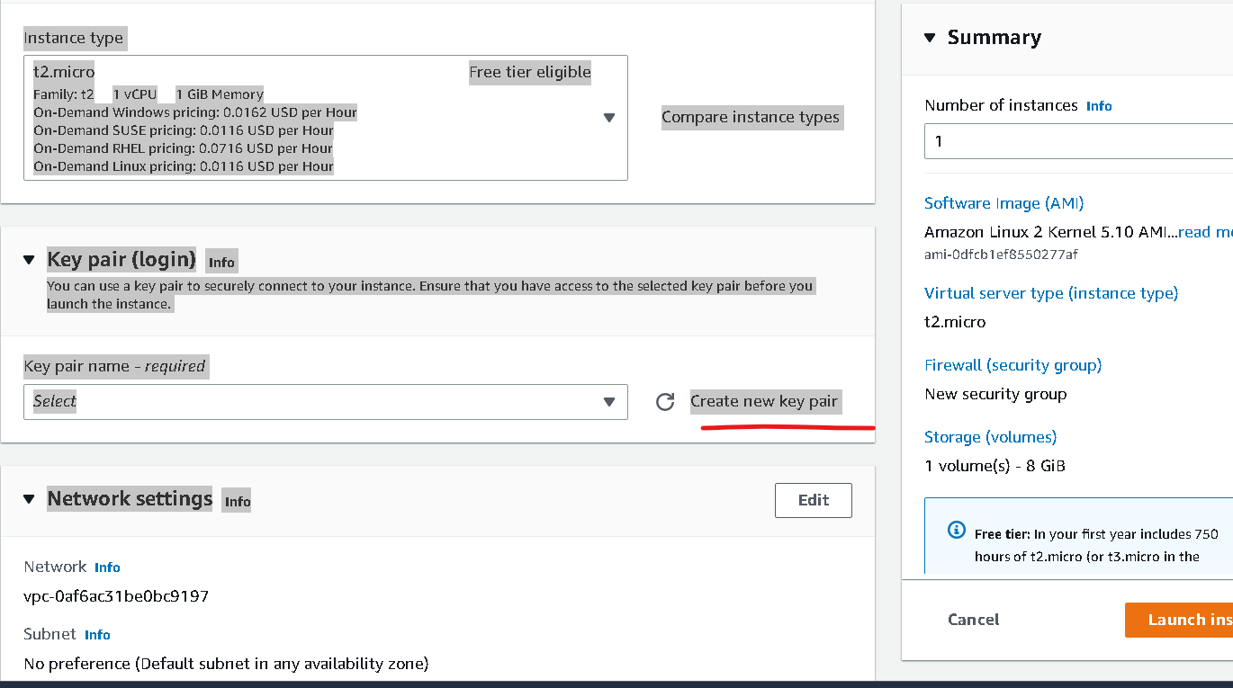
Click on create key

Slide 14
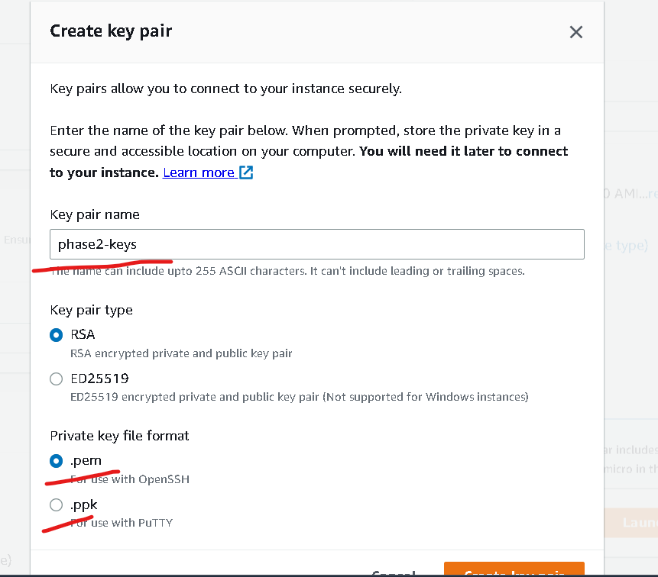
Create the key (please remember path of the file which help to connect to instance )
Keyname is phase2-keys
Private key file format
.pem
If client is SSH client you can create
In MAC or unix we can use normal terminal as SSH client but in window we have to use gitbash which support SSH client
.ppk : this for window with putty tool.

Slide 15
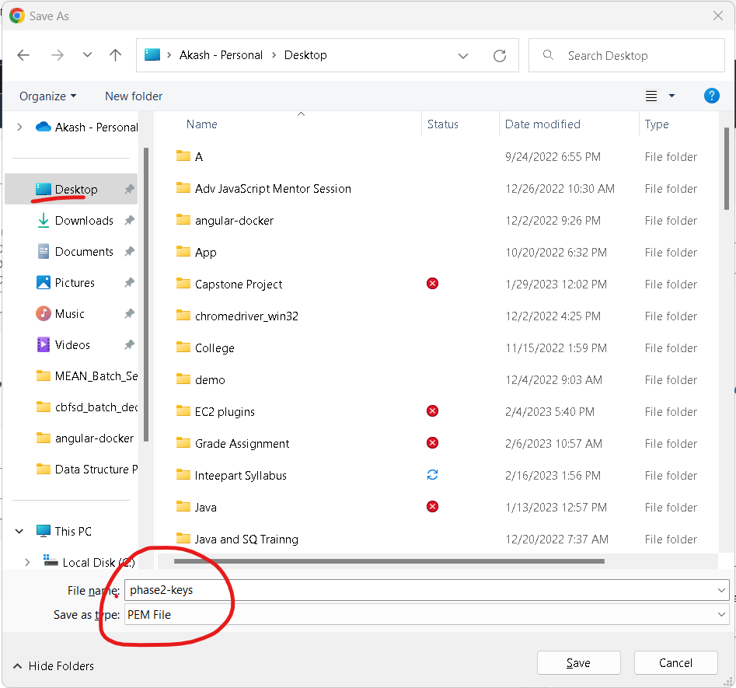

Slide 16
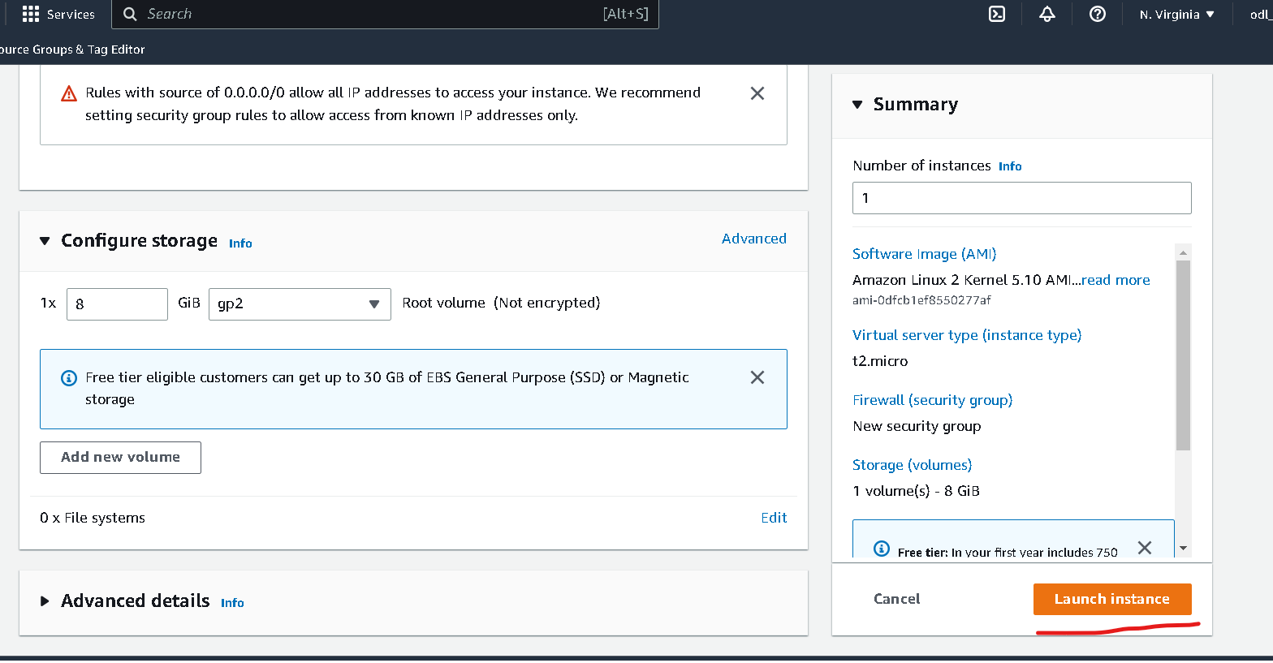
Other option are default don’t do any changes

Slide 17
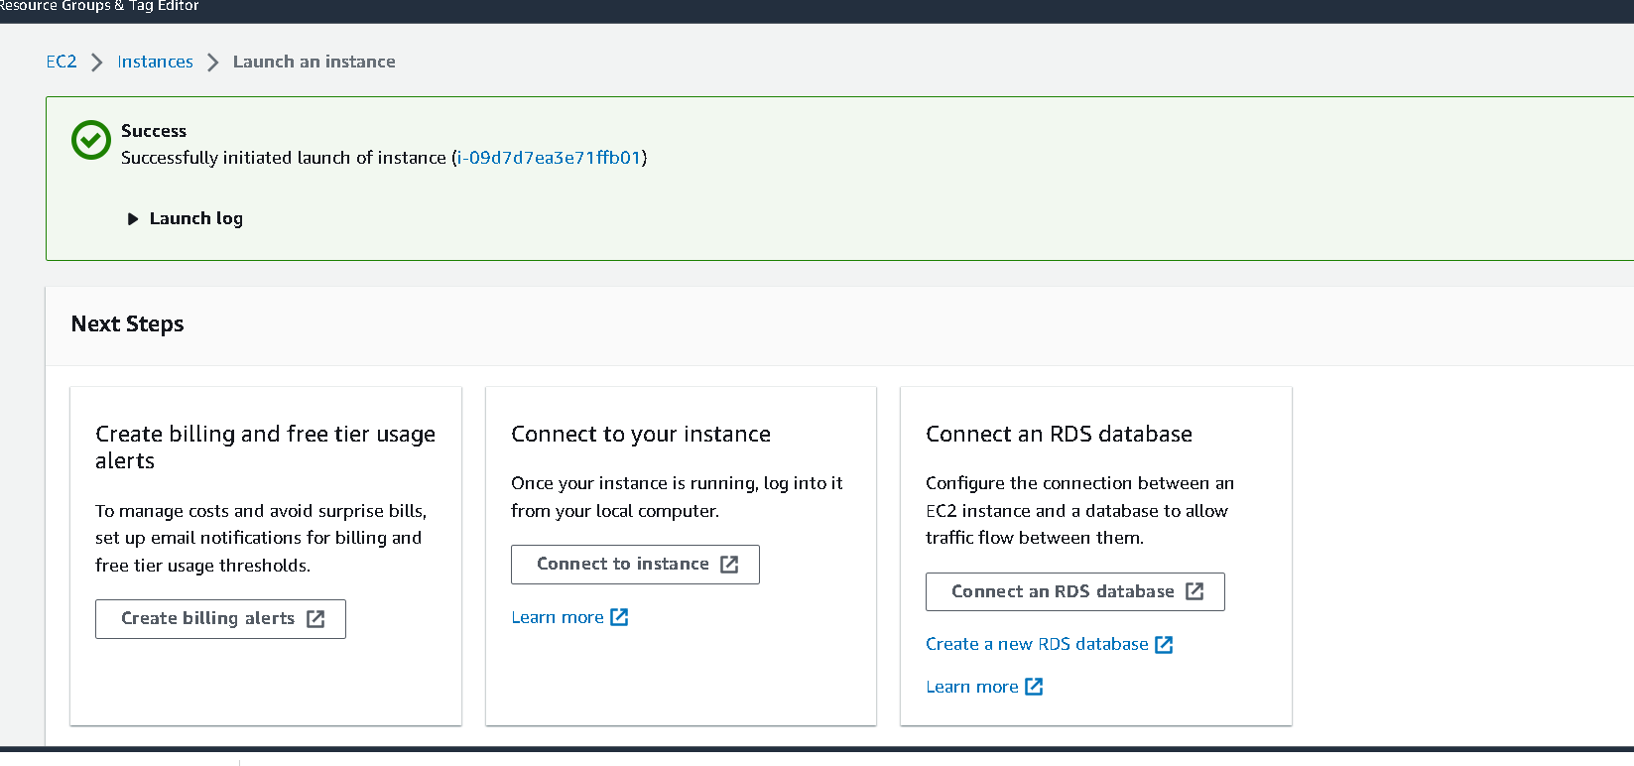

Slide 18
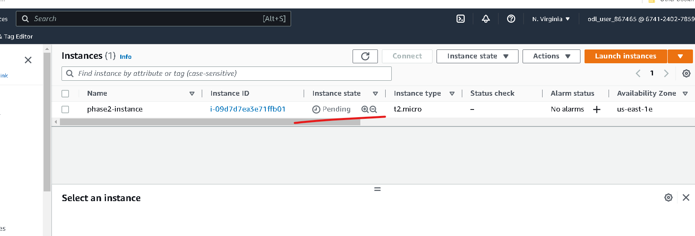
Wait for few minutes to instance to run

Slide 19
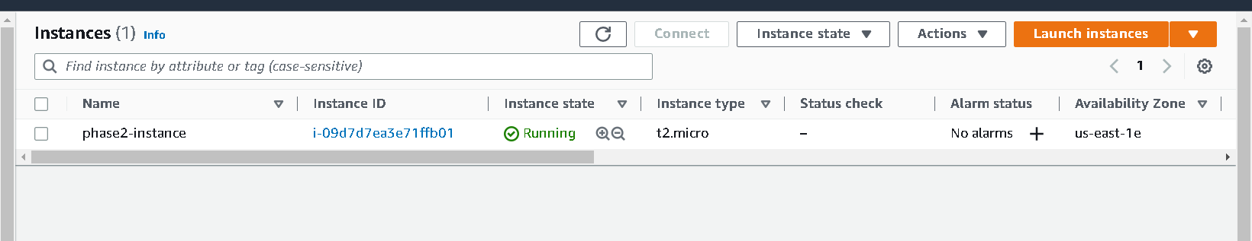
Once instance up

Slide 20
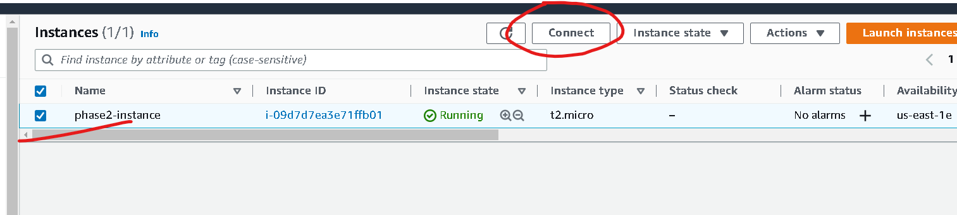
Now click on check box of instance and click on connect

Slide 21
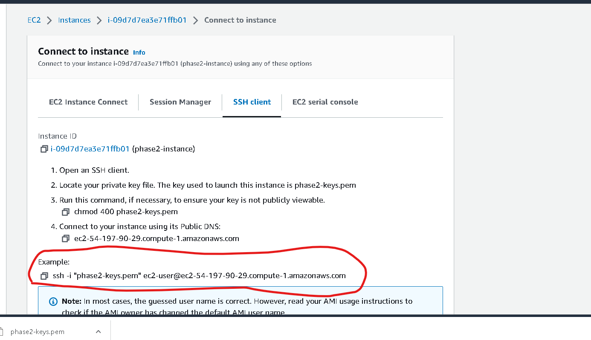
Now you have to copy and example code content which help to connect running instance through ssh client

Slide 22
Steps to connect instance
If you are connecting from window please using gitbash. Open gitbash in the location where .pem file present
If you are connection from unix or mac. Please open terminal in that location where .pem file present.

Slide 23
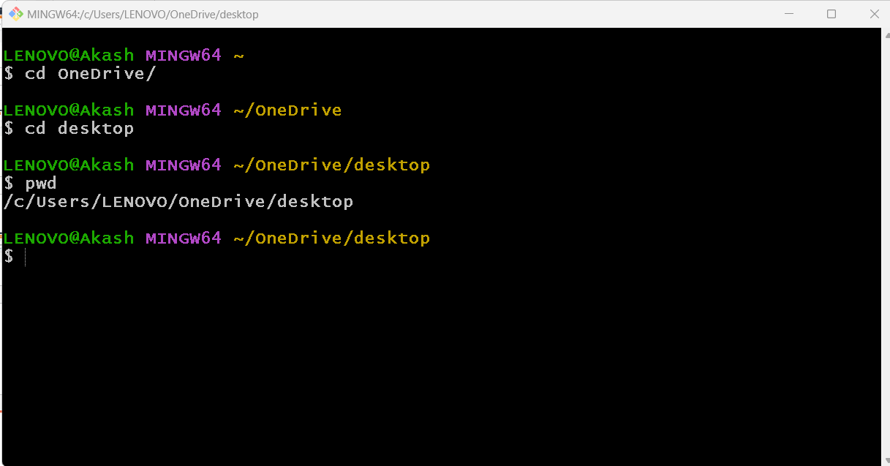
My file present in desktop so I have point to desktop using gitbash

Slide 24
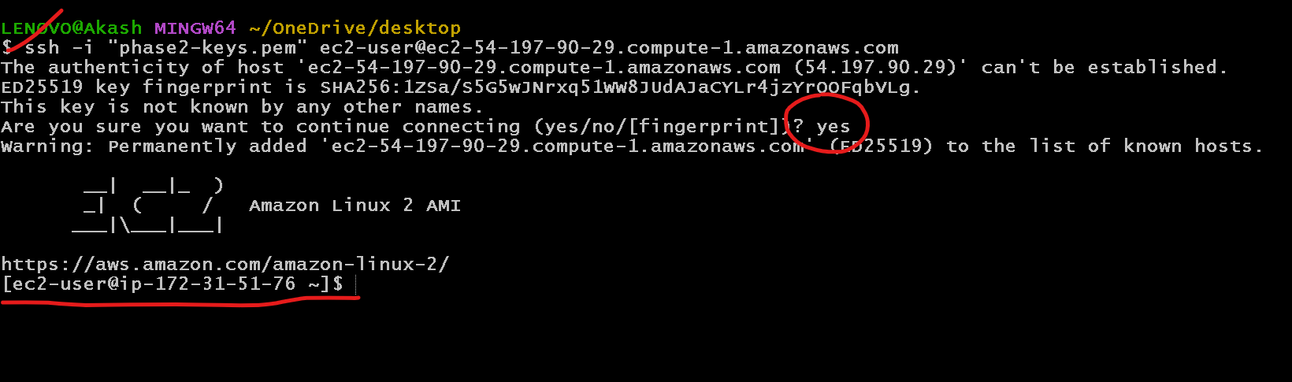
Please paste that command to connect this terminal to aws instance

Slide 25
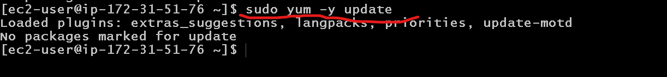
We need to update instance using command as
sudo yum –y update

Slide 26
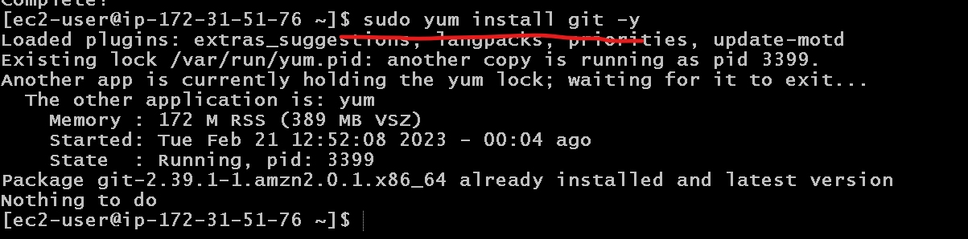
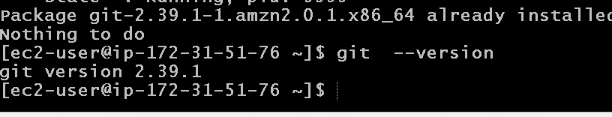
Now we need to instance git in ec2 instance
sudo yum install git –y

Slide 27
Now we will install the docker in EC2 instance
This command is use to install the docker
sudo yum -y install docker
This command is use to start the docker
sudo service docker start
This command is use to verify docker details
sudo docker info
This command is use to verify docker version and docker images
sudo doker –version
sudo docker images

Slide 28
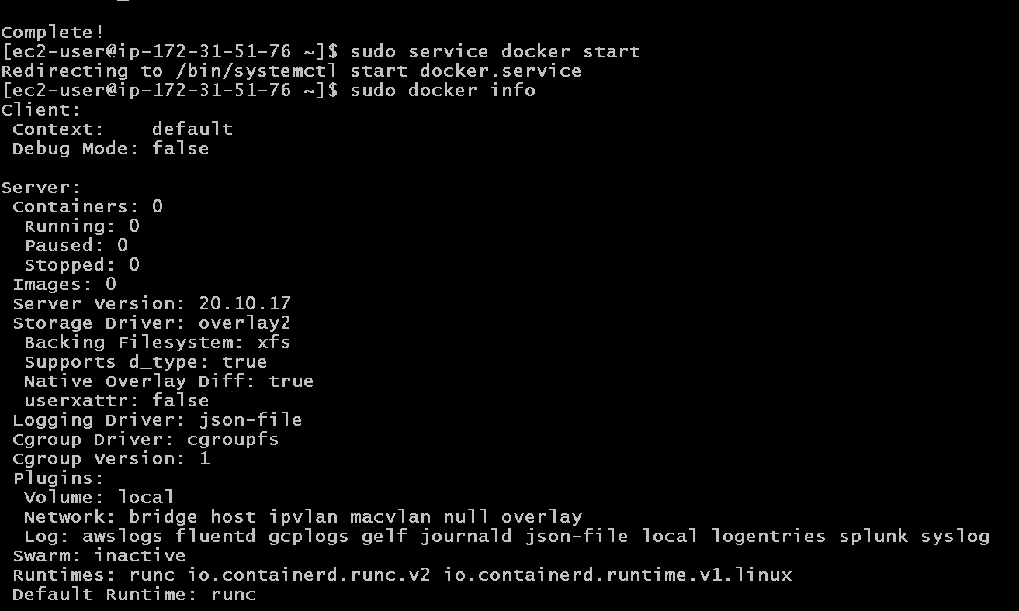

Slide 29
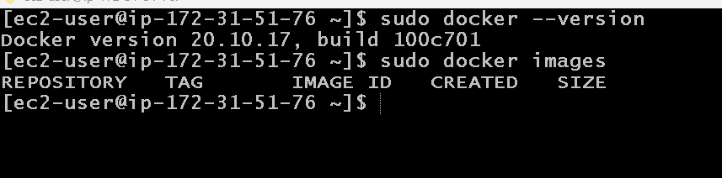

Slide 30
Now we will install Jenkin CI and CD tool in EC2 instance
Before Jenkin installation we need to install Java 11 because Jenkin is base upon the Java 11.
sudo amazon-linux-extras install java-openjdk11
It will ask you y/n :please enter y
java --version

Slide 31
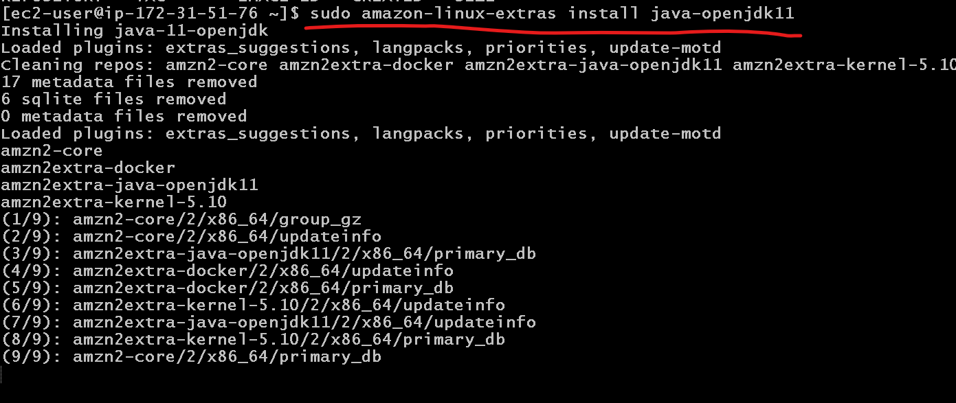

Slide 32
Now we will install jenkin
Pull jenkin software
sudo wget -O /etc/yum.repos.d/jenkins.repo https://pkg.jenkins.io/redhat/jenkins.repo
Extract that software
sudo rpm --import https://pkg.jenkins.io/redhat-stable/jenkins.io.key
Now install this software
sudo yum install Jenkins (please enter y) if it ask.
Then we need to start the service
sudo service jenkins start
To check the service status
sudo systemctl status jenkins

Slide 33
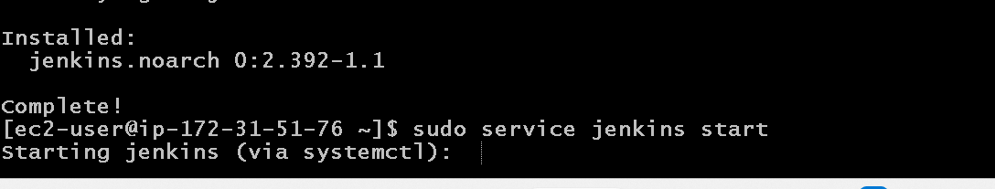
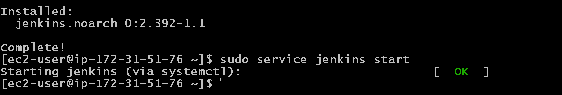
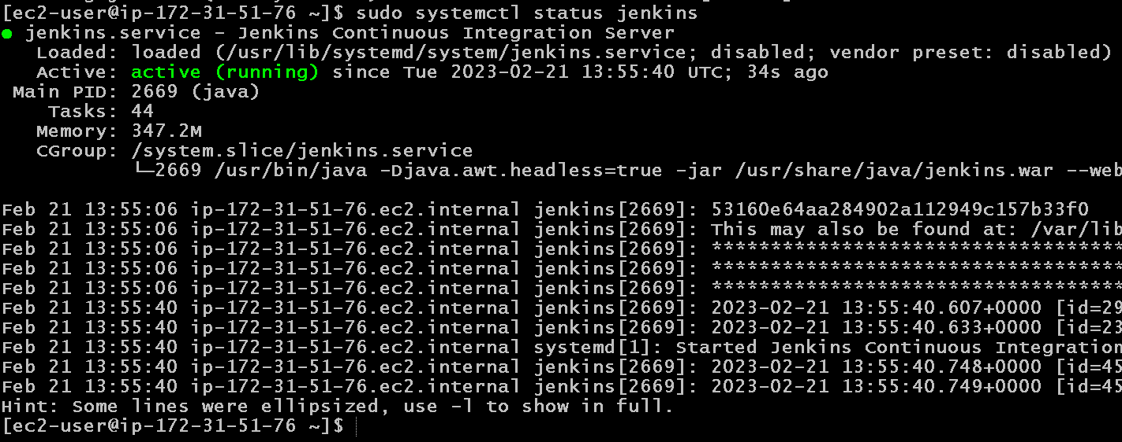

Slide 34
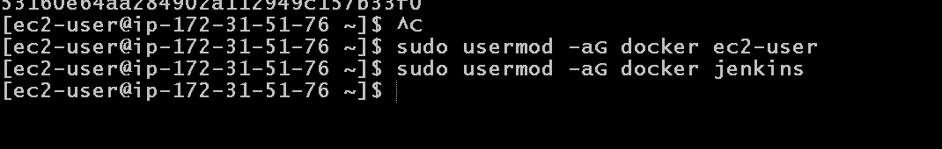
Now we will add usermod Jenkin and docker
sudo usermod -aG docker jenkins
sudo usermod -aG docker ec2-user

Slide 35
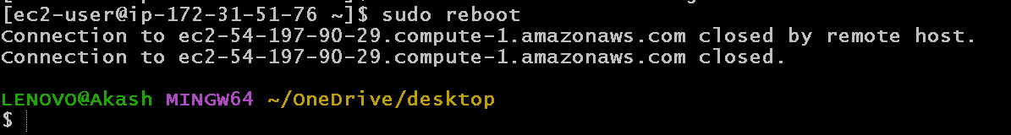
To get the effect please reboot ec2 instance
sudo reboot
After reboot please wait new minutes then reconnect

Slide 36
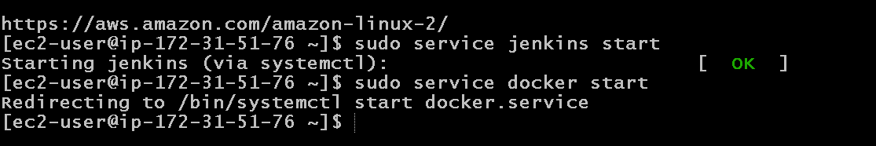
After re-connected to ec2 instane
We need to start Docker and Jenkin once again
sudo service docker start
sudo service jenkins start

Slide 37
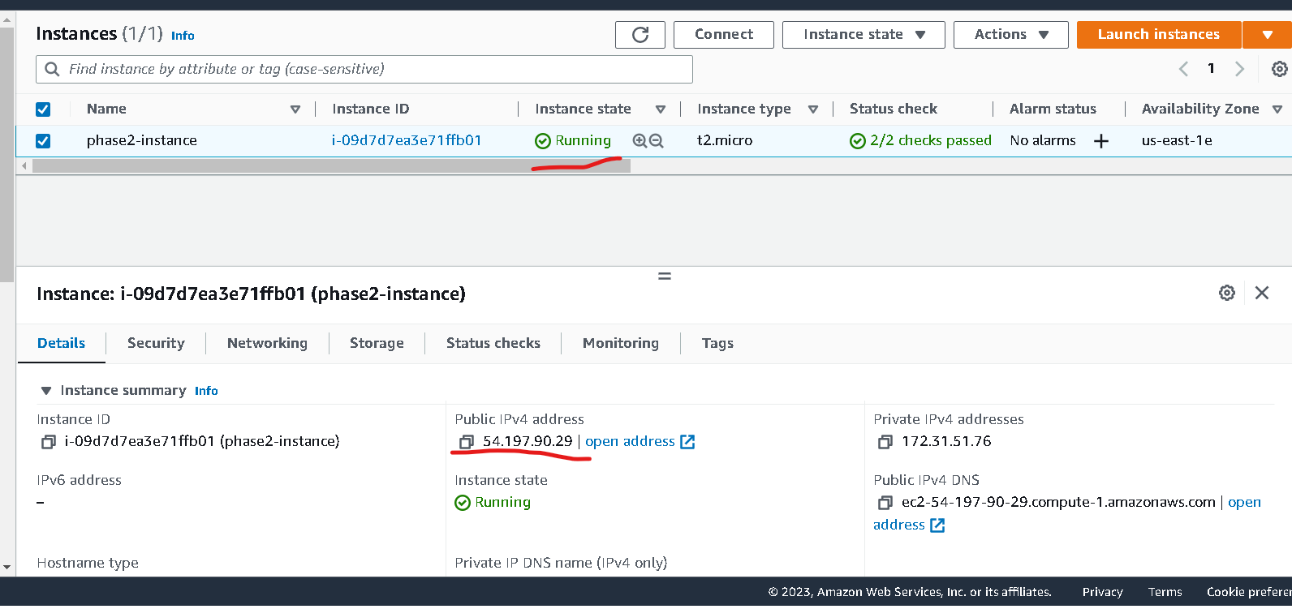
Check ec2-instance ip address

Slide 38
Application running on port number
Jenkin running on port number 8080 (default port number).
Nginx server running on port number 80( default port number).
So now we need to open both port number in inbound.

Slide 39
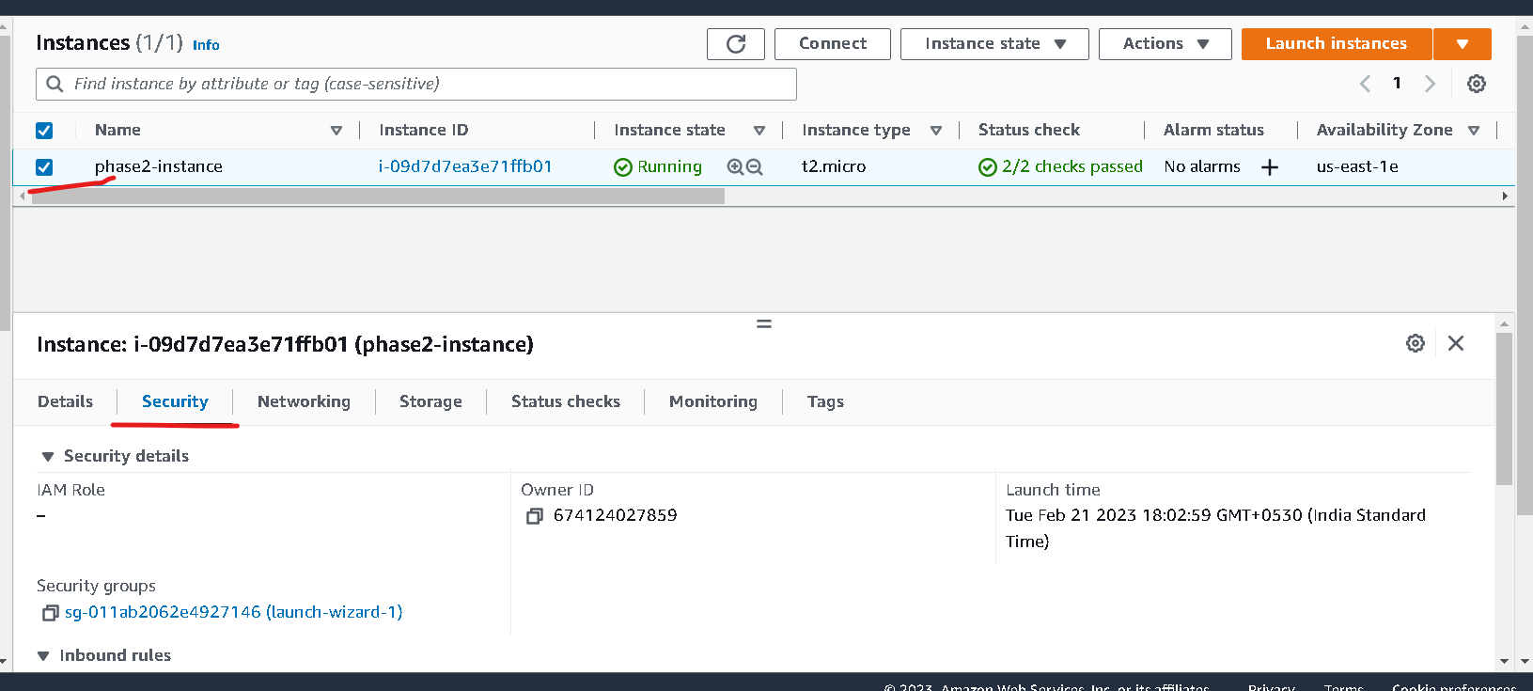
Select the security option

Slide 40
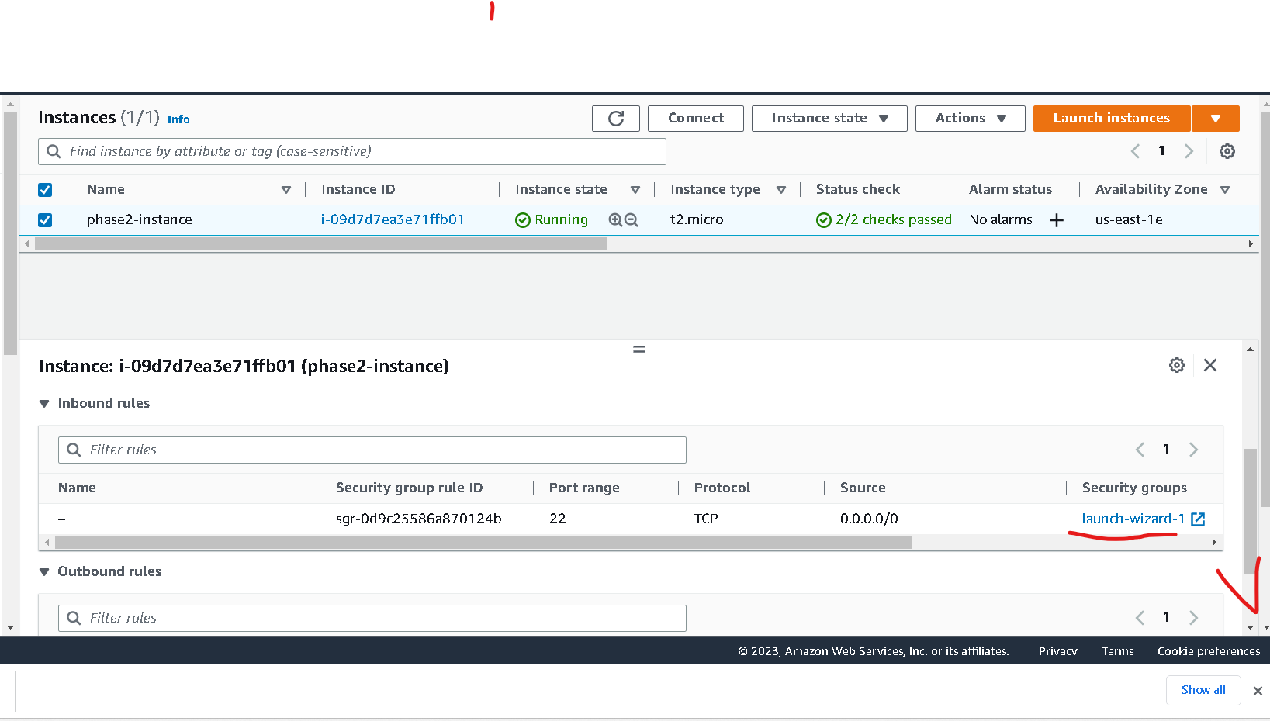
Search security launch wizard

Slide 41
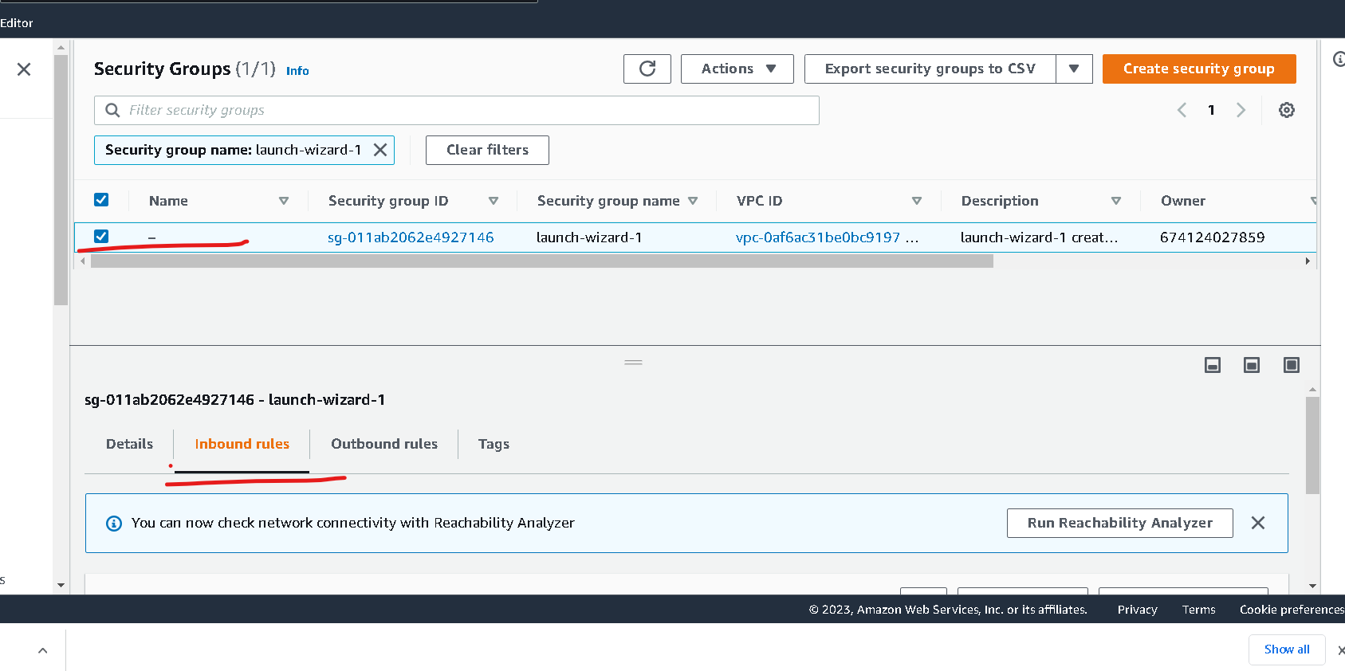
Once you click on launch wizard it open another tab in browser.

Slide 42
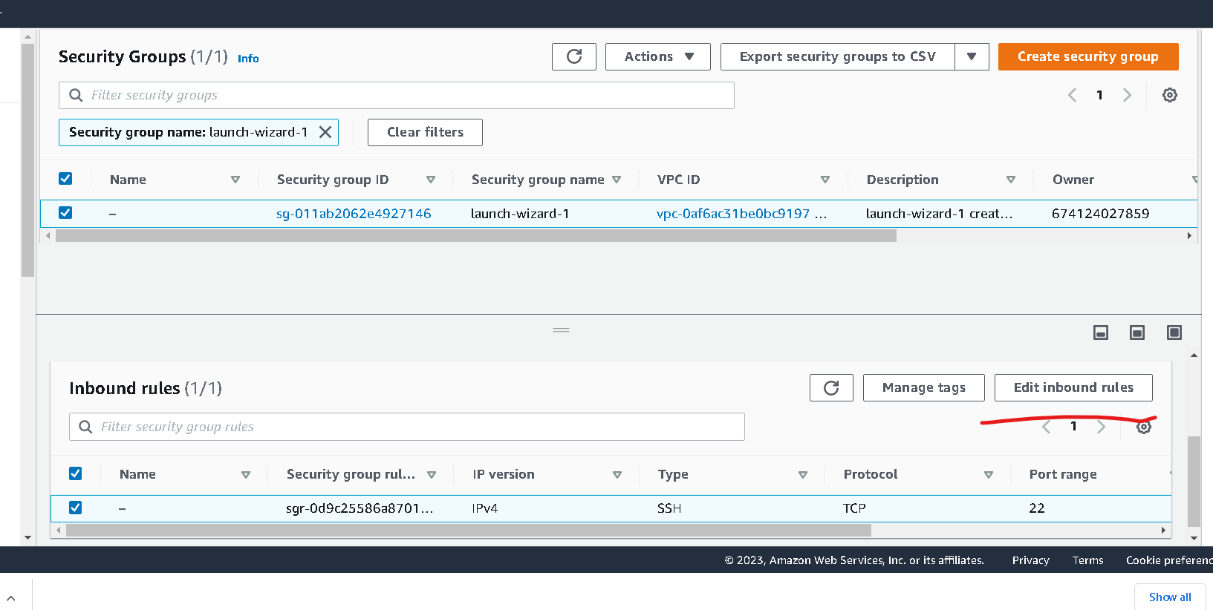
Search edit inbound rules

Slide 43
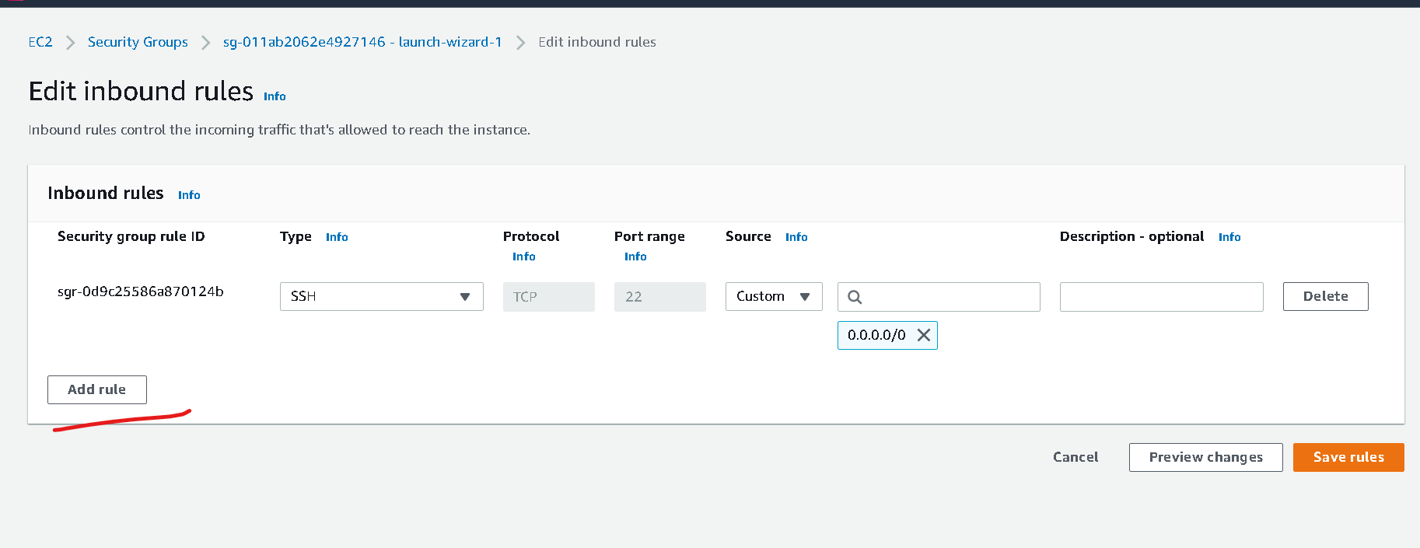

Slide 44
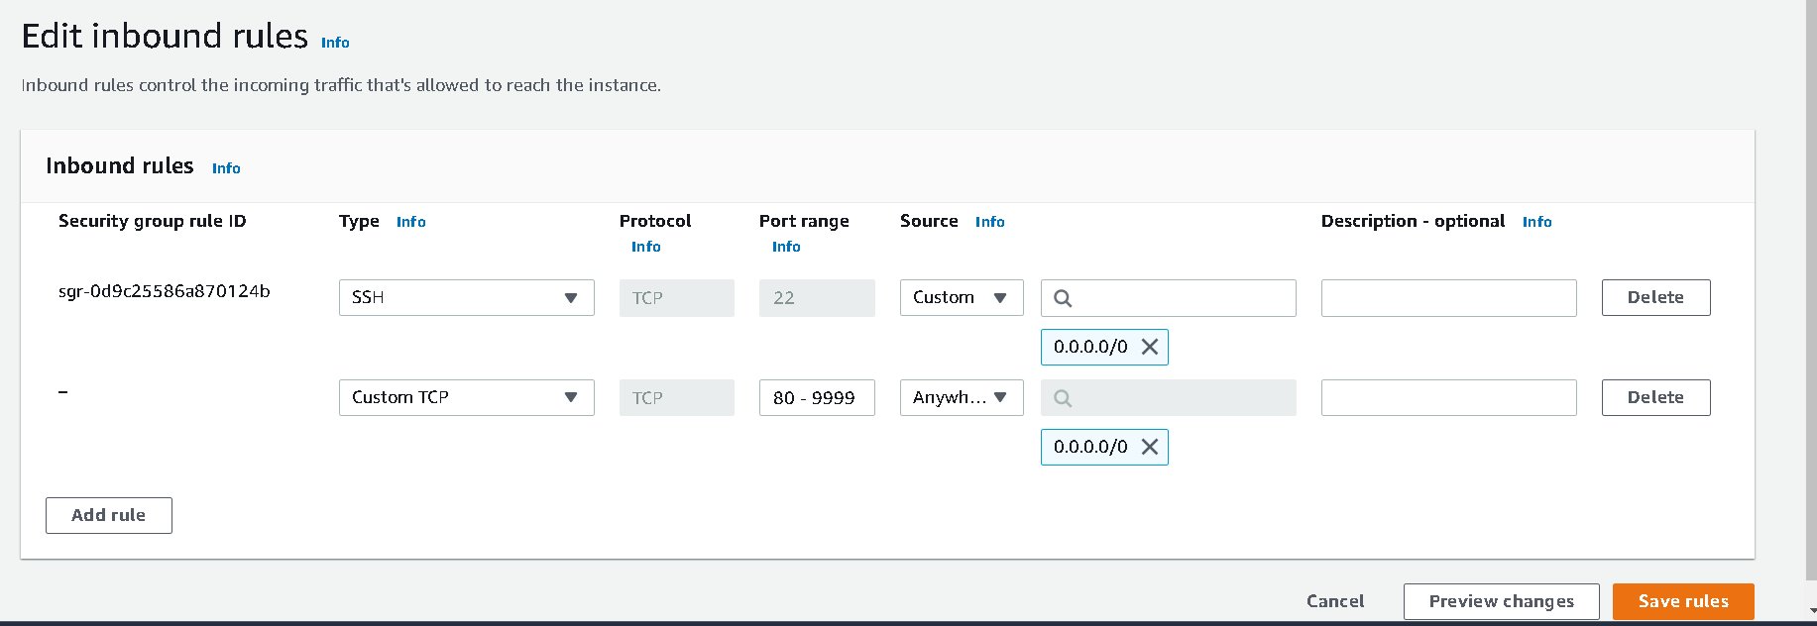
Click on add rule
Type must be : custom type
Protocol : TCP
Port range : 80-9999 ( means we can use any port number between range 80 to 9999)
Source : anywhere
Click on save rules

Slide 45
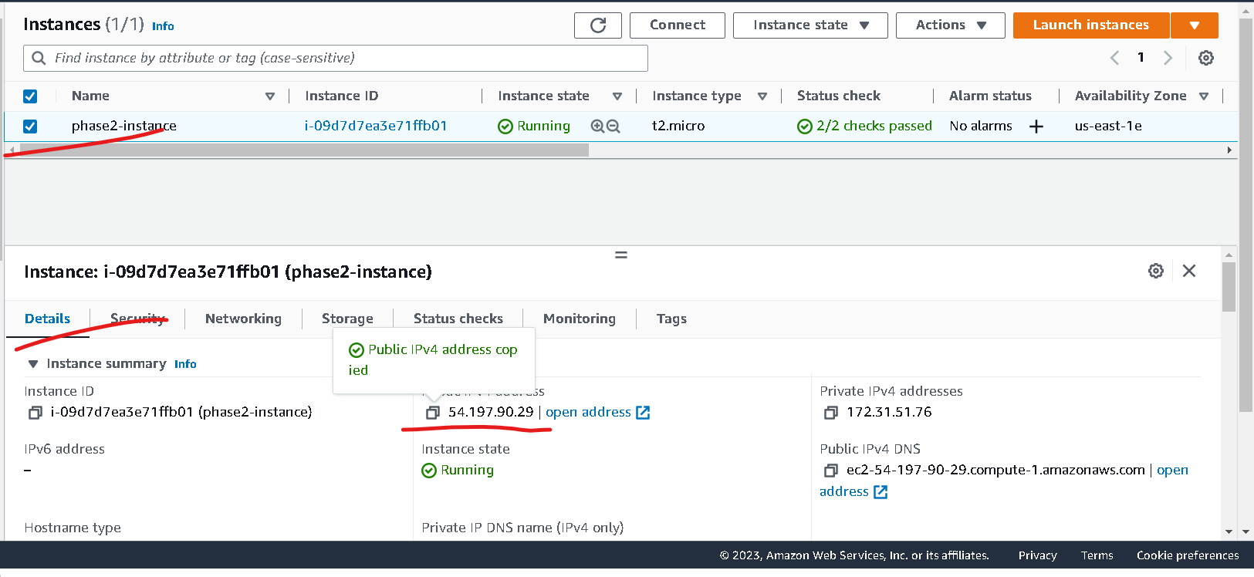
Check your ec2 instance ip address

Slide 46
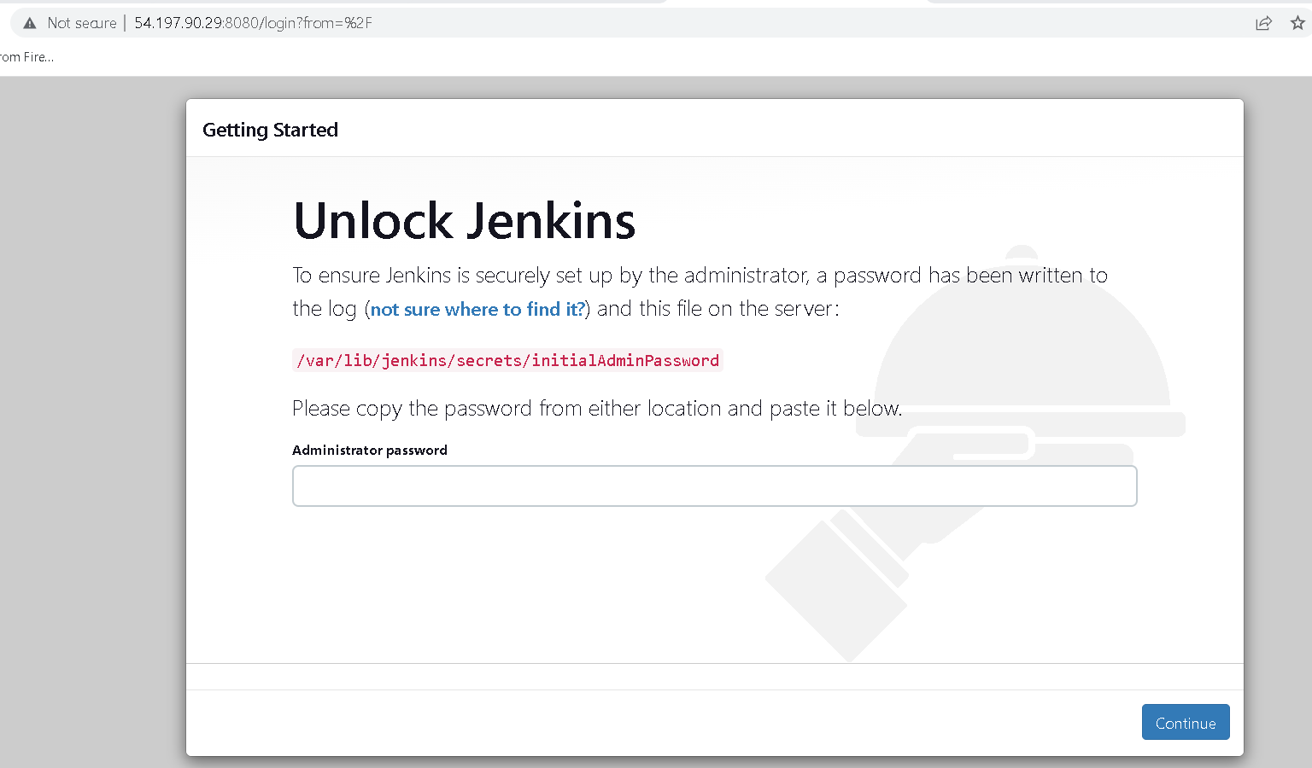
Now using IP address with port number 8080 check jenkin running or not.
For my ip address with http://54.197.90.29:8080/

Slide 47
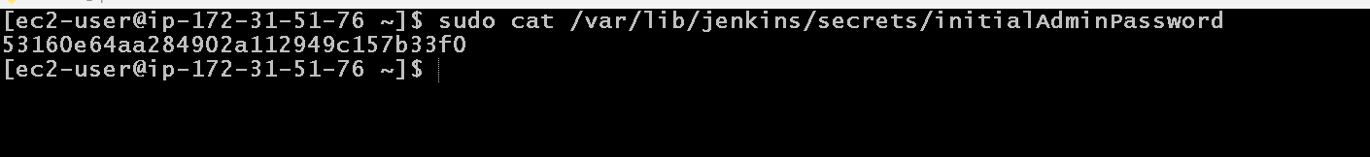
After running jenking
The default user name is :admin and password is random password generated by jenkin.
To get that password you need to run the command in ec2-instance terminal ie gitbash
sudo cat /var/lib/jenkins/secrets/initialAdminPassword

Slide 48
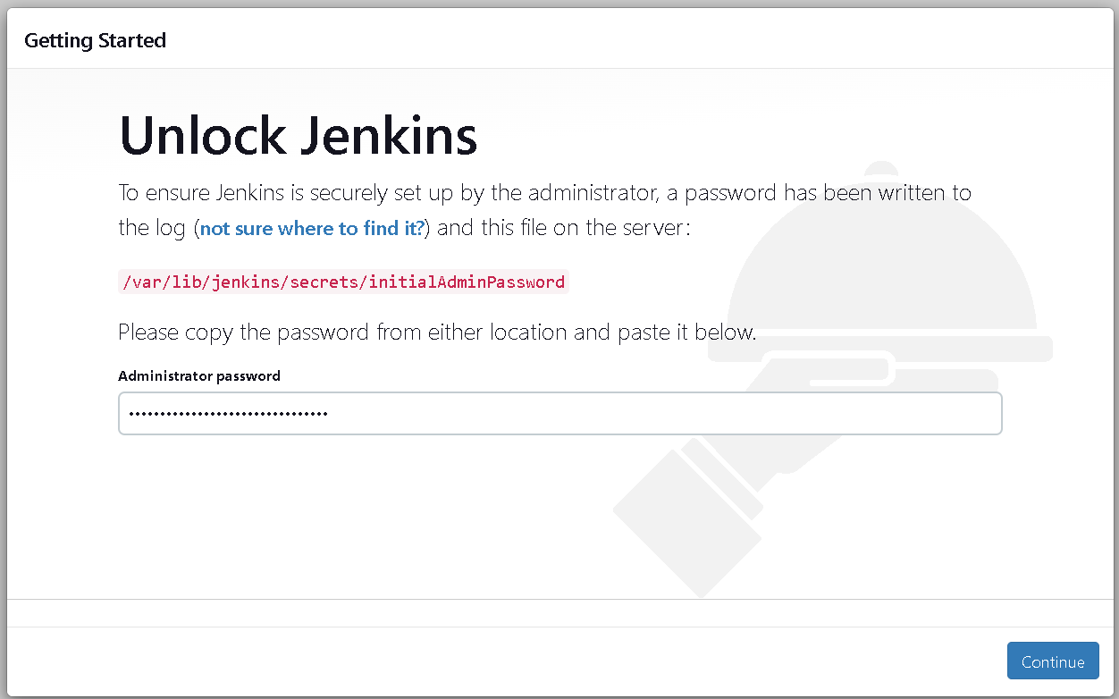
Paste this password

Slide 49
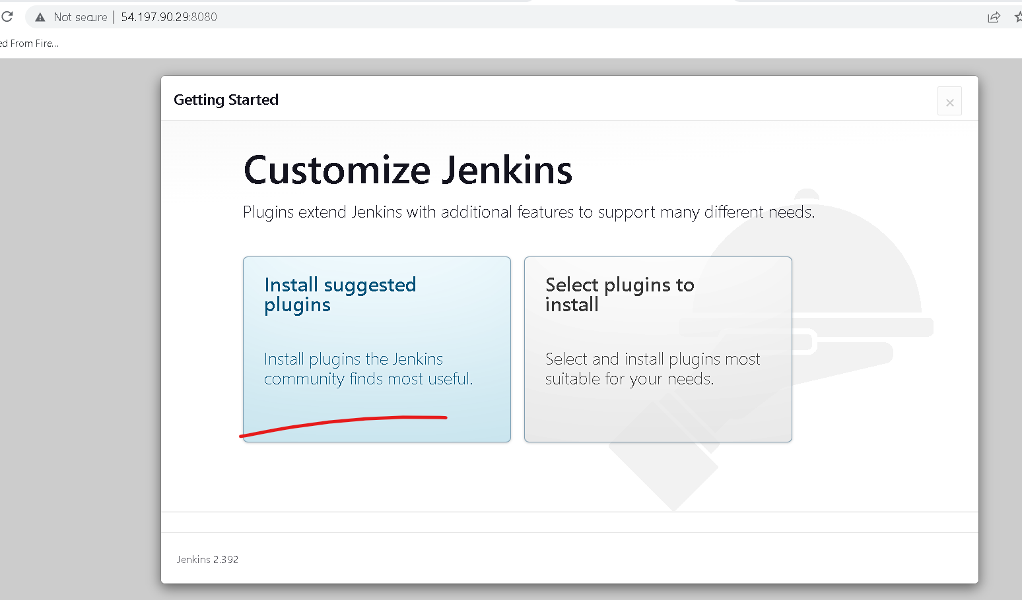
After password paste it will ask to install plugin. Please install suggested plugin

Slide 50
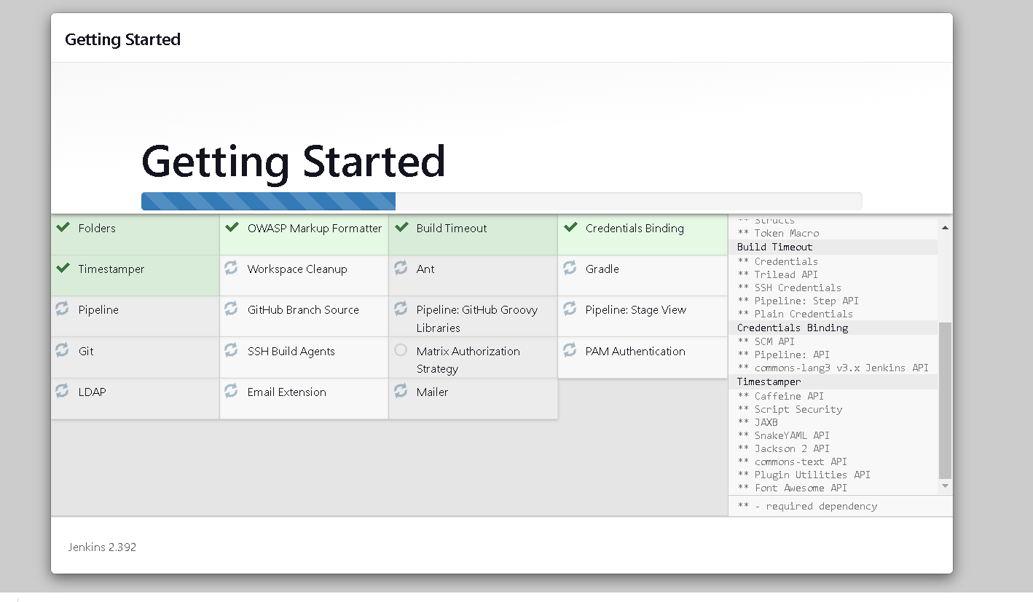
Wait to install all plugin

Slide 51
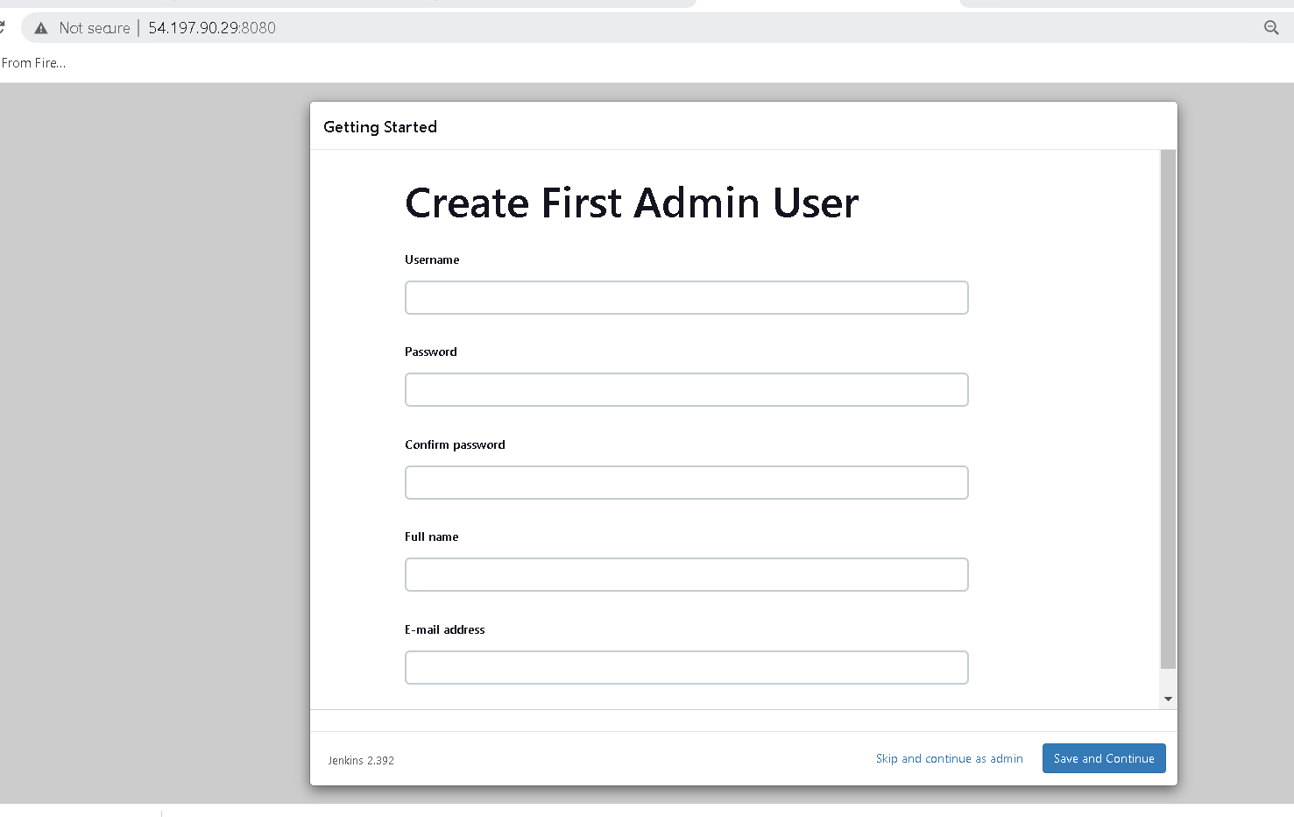
Now you need to create the account

Slide 52
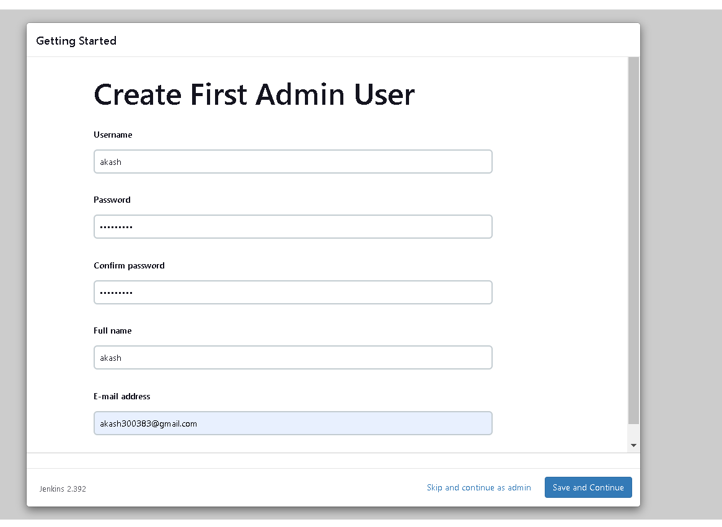

Slide 53
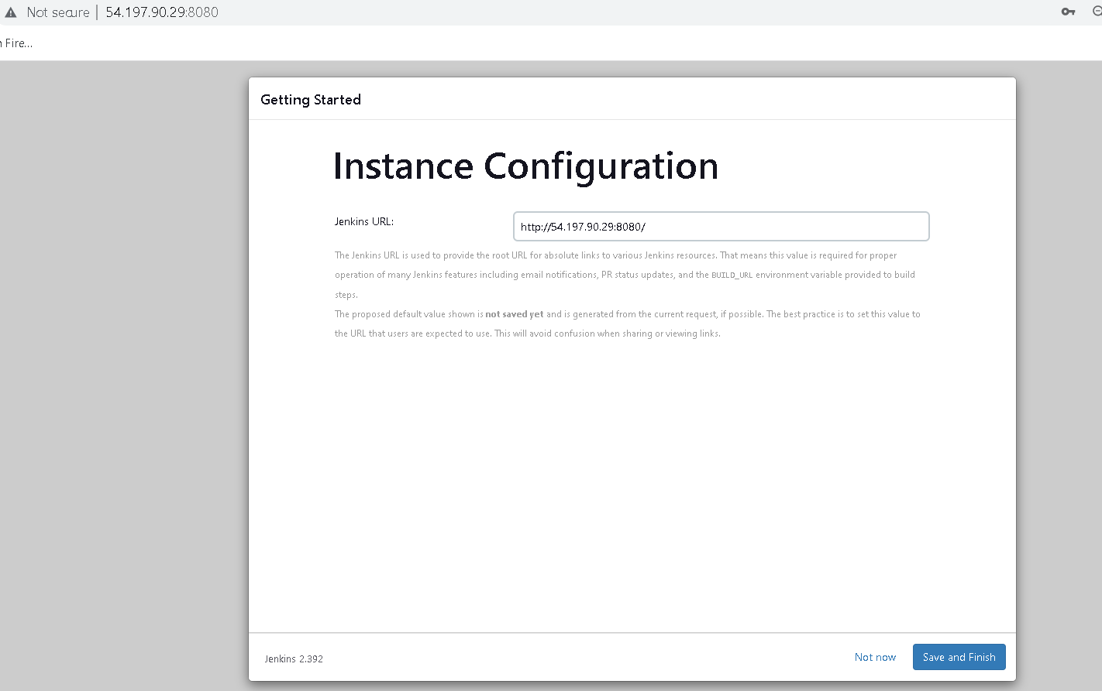

Slide 54
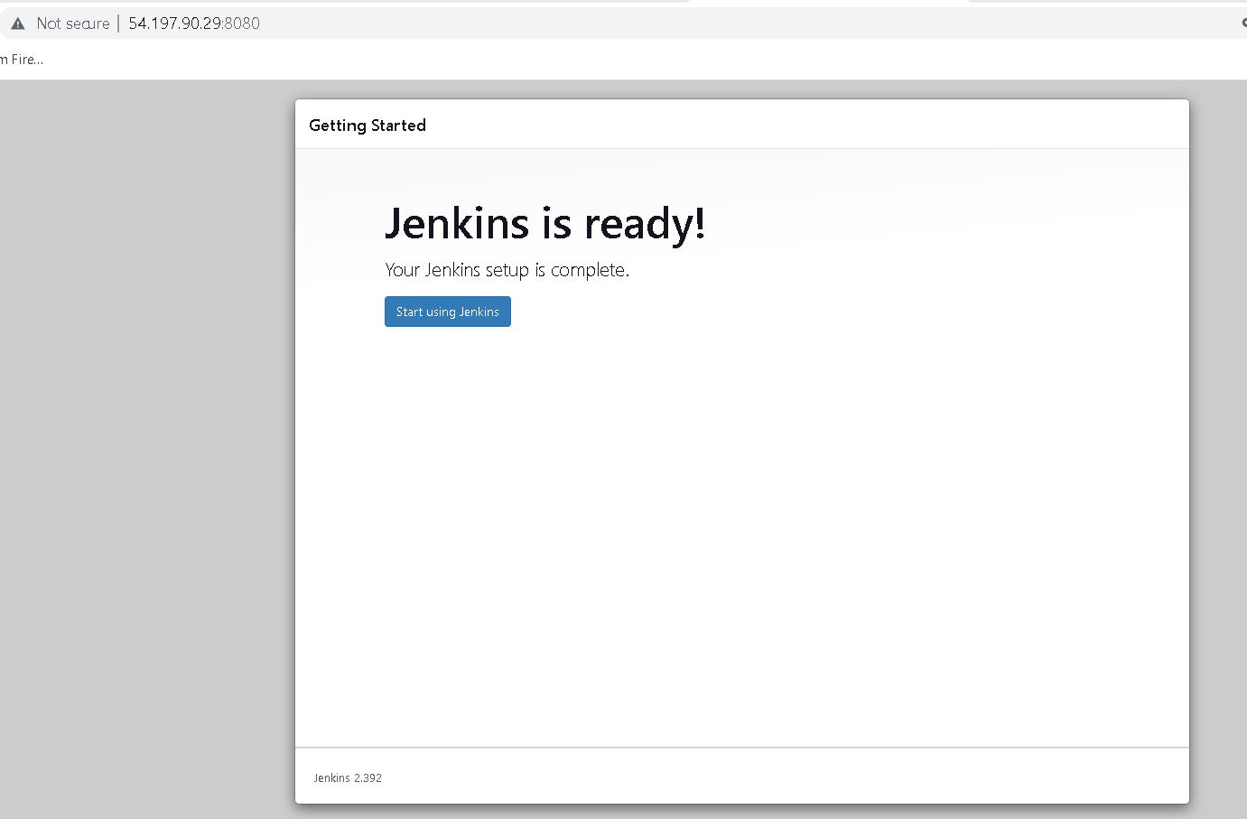

Slide 55

Jenkin dashboard

Slide 56
Now we will create the Jenkin job
This job is responsible to
Pull phase1 project from git
Then create docker image that Dockerfile present in git repository
Then it will run image on ec2 instance
So Ec2 instance provide ip address to access the phase 1 project which we are going to run the jenkin with docker.

Slide 57

Click on new item

Slide 58

General

Slide 59

Source code management https://github.com/Kaleakash/phase1_food_ordering.git

Slide 60

Please check git branch the default names is master consider

Slide 61

In git check the branch name

Slide 62
Both branch must be same if in git branch name may be main then in Jenkin job please make it main.

Slide 63

Build steps - select execute shell

Slide 64

First we will check all environment
git --version
docker --version

Slide 65

Now you have to click on build
If build success we will get green color in hyper link
If build fail we will get red color in hyper link

Slide 66

Now we will docker the docker image
So click once again on configure option

Slide 67
If build fail then run below command in ec2-instance terminal
sudo chmod 777 /var/run/docker.sock
This command is use to give permission to jenkin to create docker images in Jenkin environment.

Slide 68

Now you have to verify it will create the images or not

Slide 69

If this job build successfully the run image

Slide 70

Please check console output

Slide 71

You can verify this images or container in ec2 instance terminal

Slide 72
Now you can check this application running or not.
http://ipaddress:80

Slide 73


Slide 74


Slide 75


